Slide 1

DIABETIC RETINOPATHY DETECTION
Rudolph Almeida 05
Niral Almeida 04
Melissa D’Cunha 20
Date of Presentation: 10th November, 2017
Under the guidance of: Miss. Vincy Joseph
Department of Computer Engineering,
St. Francis Institute of Technology

Slide 2

CONTENTS
Introduction
Problem Statement and Proposed Solution
Scope of Project
Review of Literature
System Description
Hardware and Software Requirements
User Interface Design
Conclusions
Plans for Next Semester
Literature Cited
Acknowledgements

Slide 3
INTRODUCTION
Diabetic Retinopathy is the leading cause of blindness in the developing world
Diabetic Retinopathy is caused by long standing cases of diabetes
It can be stopped if it is detected in time
However, this is difficult as the disease shows little symptoms until it is too late

Slide 4
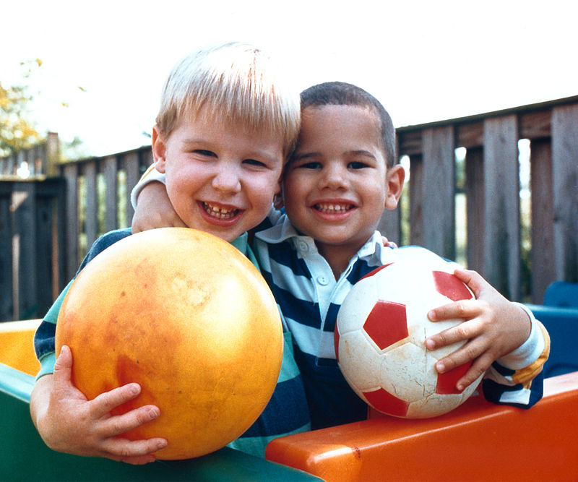
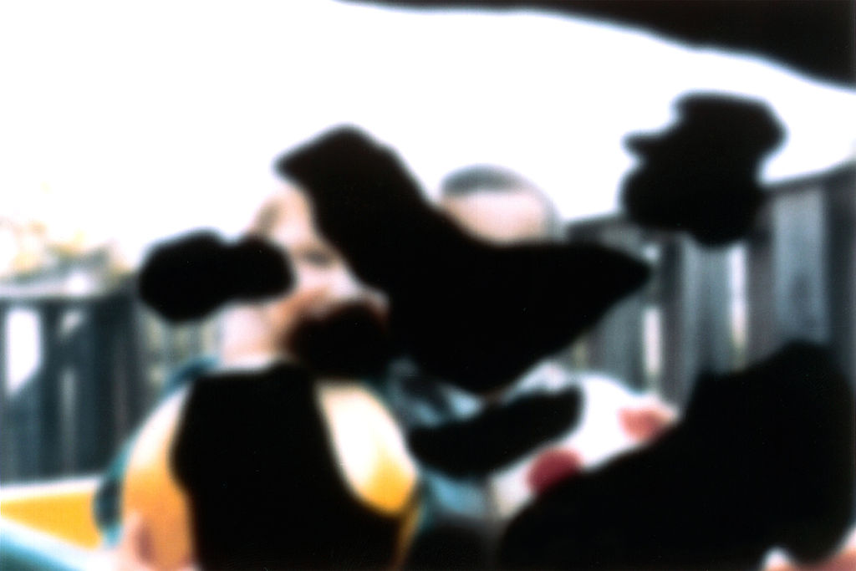
VISION WITH DIABETIC RETINOPATHY
NORMAL VISION
VISION WITH DIABETIC RETINOPATHY

Slide 5
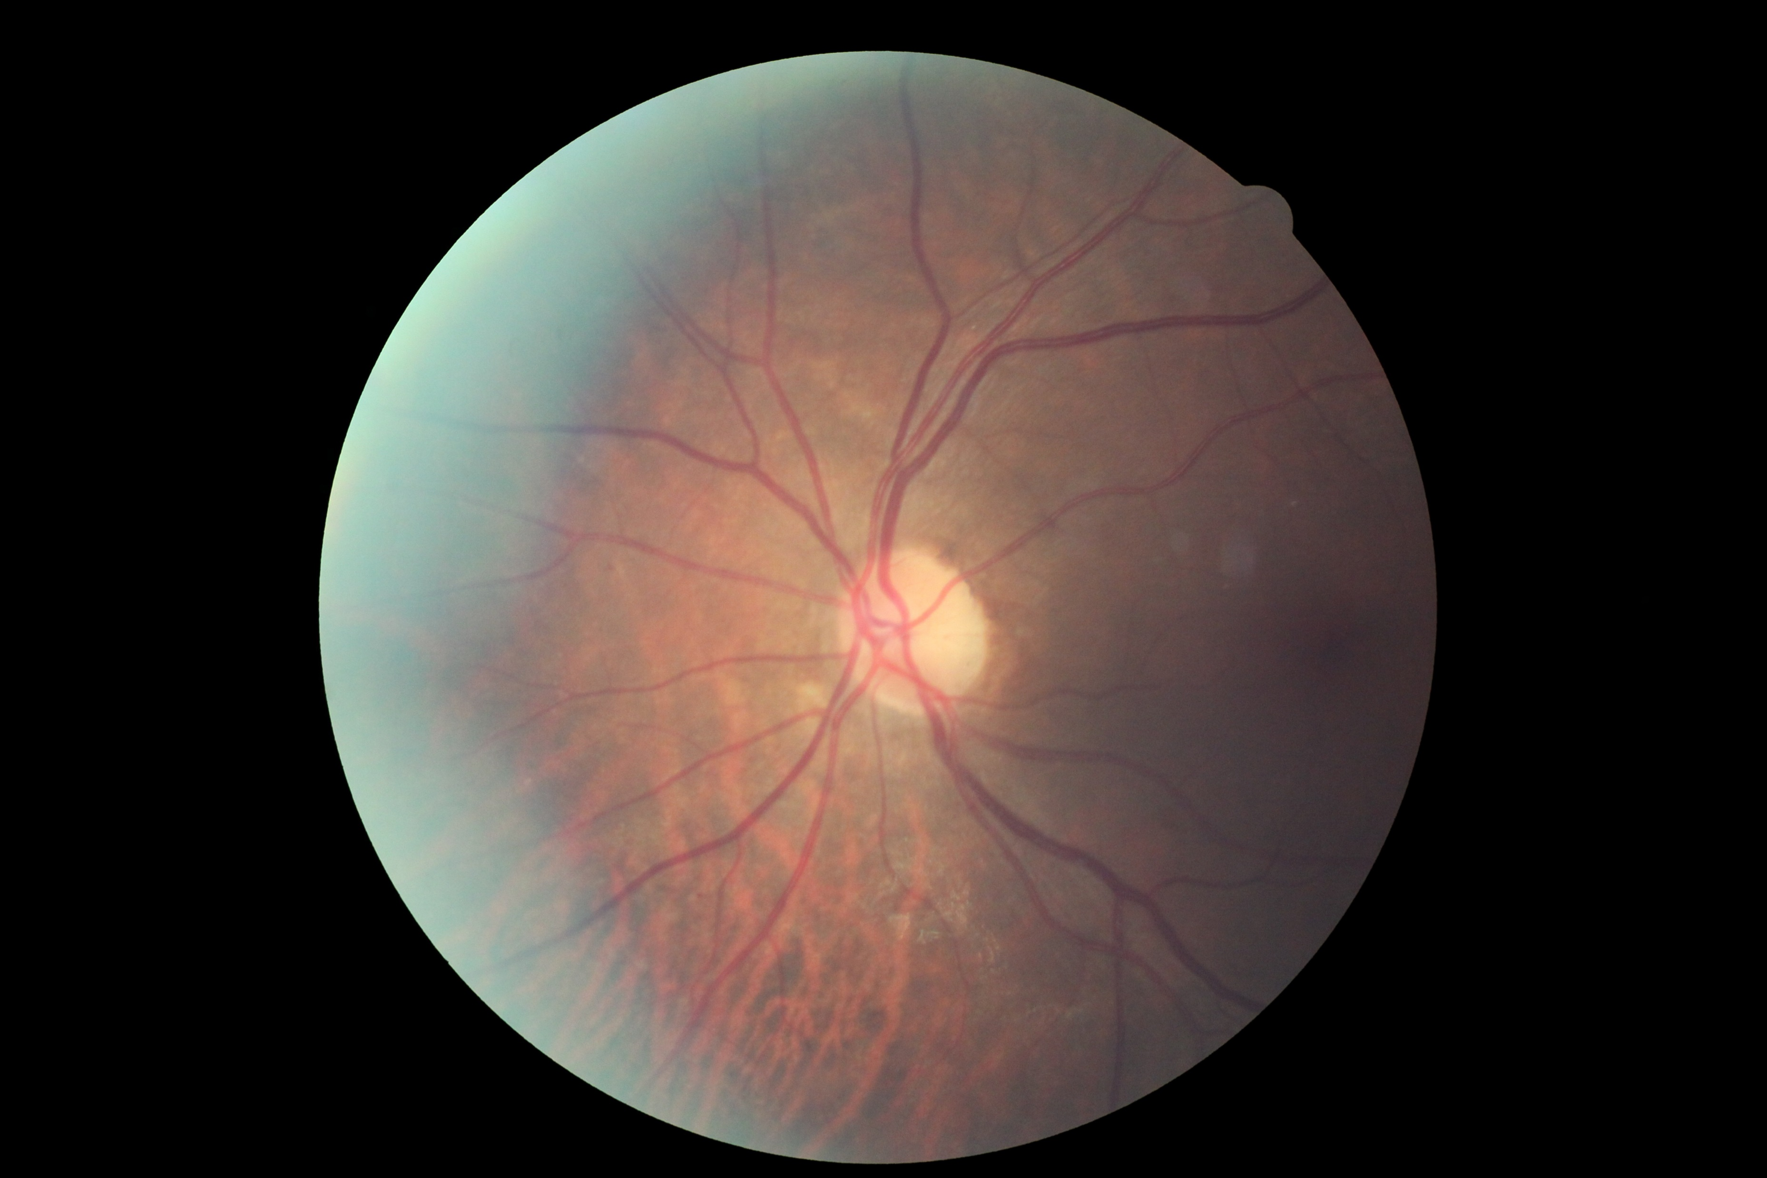
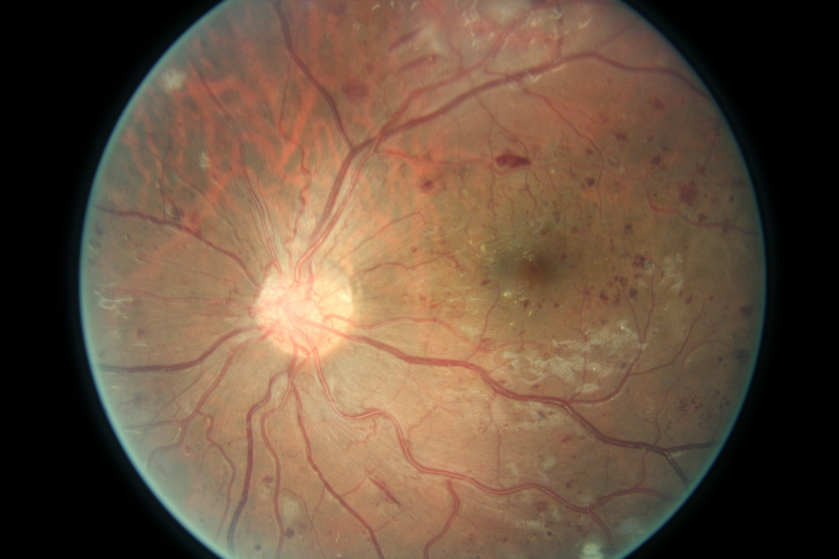
COLOR FUNDUS PHOTOGRAPHS
With Rating 0
No DR
With Rating 4
Proliferative DR

Slide 6
PROBLEM STATEMENT AND PROPOSED SOLUTION
Currently DR detection requires a trained physician, in a manual and time-consuming process.
By the time human readers submit their reviews, often a day or two later, the delayed results lead to lost follow up, miscommunication, and delayed treatment.
We plan at designing a diagnosis model that automatically learns features which are pivotal in diagnosing the stage of the disease without explicit or manual feature extraction

Slide 7
SCOPE OF THE PROJECT
The project is intended to be used by clinical experts and researchers who might want it to use to accurately predict the class of a color fundus photograph.
Clinics can employ the system to provide reports to patients at the earliest. This will hopefully lead to DR being detected at its early stages and thereby reducing the cases of serious DR among the population.
Providing accurate results is necessary and incase the medical expert notices an error made by the system, they will be able to note the error which will then be corrected by the system.

Slide 8
LITERATURE SURVEY – IMAGE PROCESSING
Image preprocessing is the processing of digital images using mathematical operations by using any form of signal processing.
Techniques to be used:
Channel Extraction
Image Reflection about X-axis
Noise Removal
Histogram Equalization

Slide 9
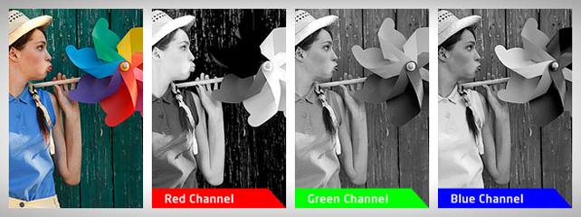
IMAGE PROCESSING –CHANNEL EXTRACTION
Training images on all 3 color channels demand high memory requirements
Hence, images need to be converted to a single channel
Experiments find, green retains information the best

Slide 10
IMAGE PROCESSING - REFLECTION
In our dataset some images are shown as one would see the retina anatomically or through a microscope condensing lens
Such images are characterized by a notch at the top right, rather than bottom right, and will be reflected about the x-axis to get them in proper position
IMAGE PROCESSING – NOISE REMOVAL
Both images and labels in our dataset contain noise
Because we don’t want the classifier to learn the inherent noise as a feature, we need to remove noise from input images

Slide 11
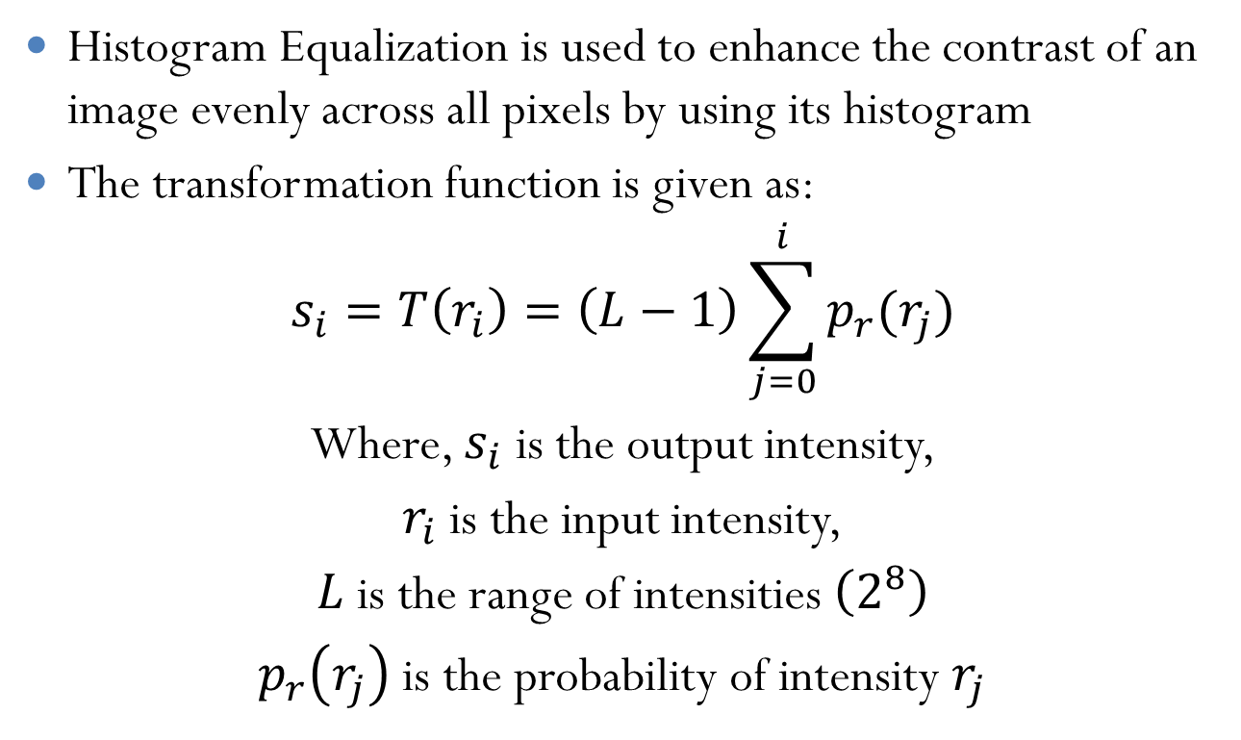
IMAGE PROCESSING – HISTOGRAM EQUALIZATION
Histogram Equalization is used to enhance the contrast of an image evenly across all pixels by using its histogram
The transformation function is given as:
$$s_{i}=T\left(r_{i}\right)=\left(L−1\right)\sum_{j=0}^{i}{p_{r}(r_{j})}$$
Where, $s_{i}$ is the output intensity,
$r_{i}$ is the input intensity,
$L$ is the range of intensities $\left(2^{8}\right)$
$p_{r}\left(r_{j}\right)$ is the probability of intensity $r_{j}$

Slide 12
LITERATURE SURVEY - CLASSIFICATION
In machine learning and statistics, classification is the problem of identifying to which a set of categories a new observation belongs, on the basis of a training set of data containing observations whose category membership is known. An example would be assigning a given email into “spam” or “not-spam” categories.
Algorithms:
Naive Bayes Classifier
Support Vector Machines
k-Nearest Neighbors
Random Forests
Convolutional Neural Networks

Slide 13
LITERATURE SURVEY - ALGORITHMS
Naïve Bayes Classifier: Naïve Bayes classifiers are a family of simple probabilistic classifiers based on applying Bayes’ theorem with string independence assumptions between the features.
Naïve Bayes classifiers are highly scalable, requiring a number of parameters linear in the number of variables in a learning problem.
Maximum-likelihood training can be done by evaluating a closed-form expressing, which takes linear time, rather than by expensive iterative approximation as used for many other types of classifiers.
Notes:
Use citations instead on links

Slide 14
LITERATURE SURVEY - ALGORITHMS
Support Vector Machines: Support vector machines(SVMs) are supervised learning models with associated learning algorithms that analyze data used for classification and regression analysis.
Given a set of training examples, each marked as belonging to one or the other of two categories, an SCM training algorithm builds a model that assigns new examples to one category or the other, making it a non-probabilistic binary linear classifier.
An SVM model is a representation of the examples as points in space, mapped so that the examples of the separate categories are divided by a clear gap that is as wide as possible.

Slide 15
LITERATURE SURVEY - ALGORITHMS
k-Nearest Neighbors: In pattern recognition, the k-nearest neighbor’s algorithm(k-NN) is a non-parametric method used for classification and regressing.
The input consists of the k closest training examples in the feature space. In classification, the output is class membership.
An object is classified by a majority vote of its neighbors, with the object being assigned to the class most common among its k nearest neighbors (k is a positive integer).

Slide 16
LITERATURE SURVEY - ALGORITHMS
Random Forests: Random Forests are an ensemble learning method for classification, regression and other tasks, that operate by constructing a multitude of decision trees at training time and outputting the class that is the mode of the classes of the individual trees.
Random decision forests correct for decision trees habit of overfitting to their training set.

Slide 17
LITERATURE SURVEY - ALGORITHMS
Convolutional Neural Networks: A CNN is comprised of one or more convolutional layers and then followed by one or more fully connected layers as in a standard multilayer neural network
The architecture of a CNN is designed to take advantage of the 2D hierarchical structure of an input image
This is achieved with local connections followed by some form of pooling which results in translation invariant features
Another benefit of CNNs is that they are easier to train and have many fewer parameters than fully connected networks with the same number of hidden layers. CNNS also consider the hierarchical representations of images while training

Slide 18
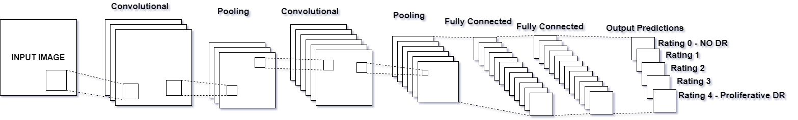
CONVOLUTIONAL NEURAL NETWORK - DIAGRAM

Slide 19
CONVOLUTIONAL NEURAL NETWORKS - COMPONENTS
Convolutional Layers: Convolutional layers apply a convolution operation to the input, passing the result to the next layer. The convolution emulates the response of an individual neuron to visual stimuli.
Pooling Layers: Convolutional networks may include local or global pooling layers, which combine the outputs of neuron clusters at one layer into a single neuron in the next layer.
Fully-Connected Layers: Fully connected layers connect every neuron in one layer to every neuron in another layer. It is in principle the same as the traditional multi-layer perceptron neural network

Slide 20
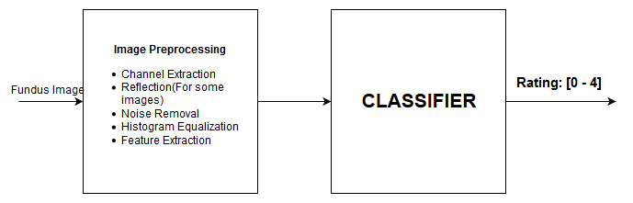
SYSTEM DESCRIPTION – BLOCK DIAGRAM
For training and application

Slide 21
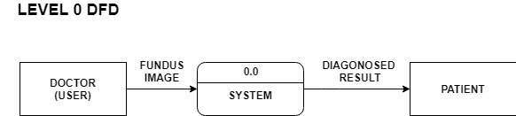
SYSTEM DESCRIPTION – DFD LEVEL 0

Slide 22
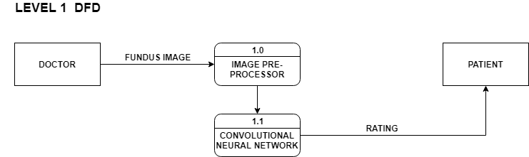
SYSTEM DESCRIPTION – DFD LEVEL 1

Slide 23
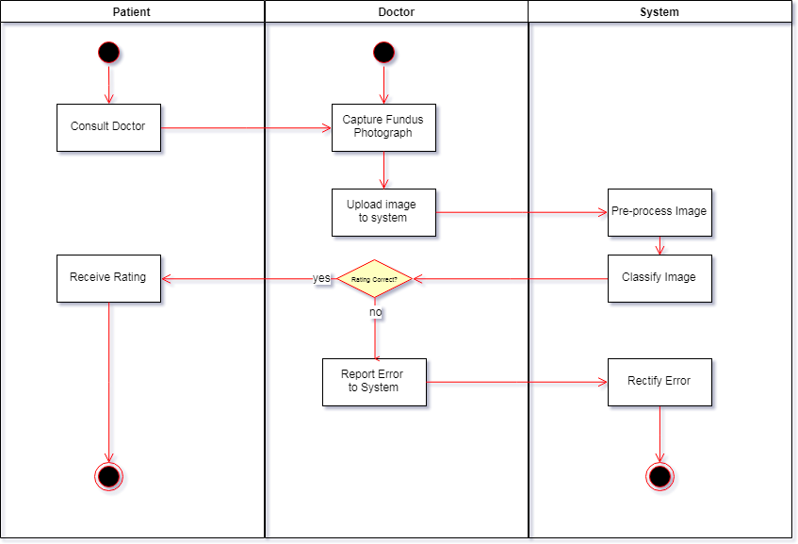
SYSTEM DESCRIPTION – ACTIVITY DIAGRAM

Slide 24
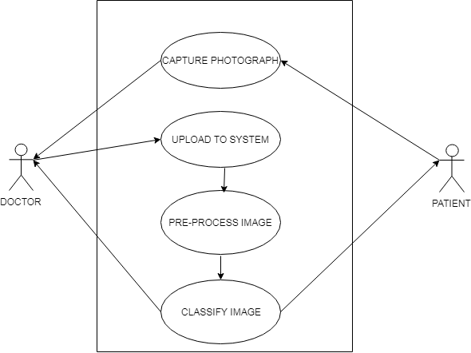
SYSTEM DESCRIPTION – USE CASE

Slide 25
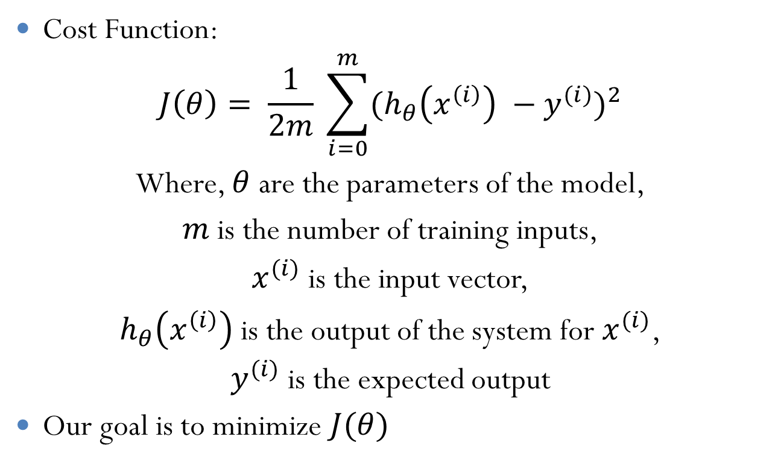
SYSTEM DESCRIPTION – ALGORITHM FOR LEARNING
Cost Function:
$$J\left(θ\right)= \frac{1}{2m} \sum_{i=0}^{m}{{(h_{θ}\left(x^{\left(i\right)}\right) −y^{(i)})}^{2}}$$
Where, $θ$ are the parameters of the model,
$m$ is the number of training inputs,
$x^{(i)}$ is the input vector,
$h_{θ}\left(x^{\left(i\right)}\right)$ is the output of the system for $x^{(i)}$,
$y^{(i)}$ is the expected output
Our goal is to minimize $J(θ)$

Slide 26
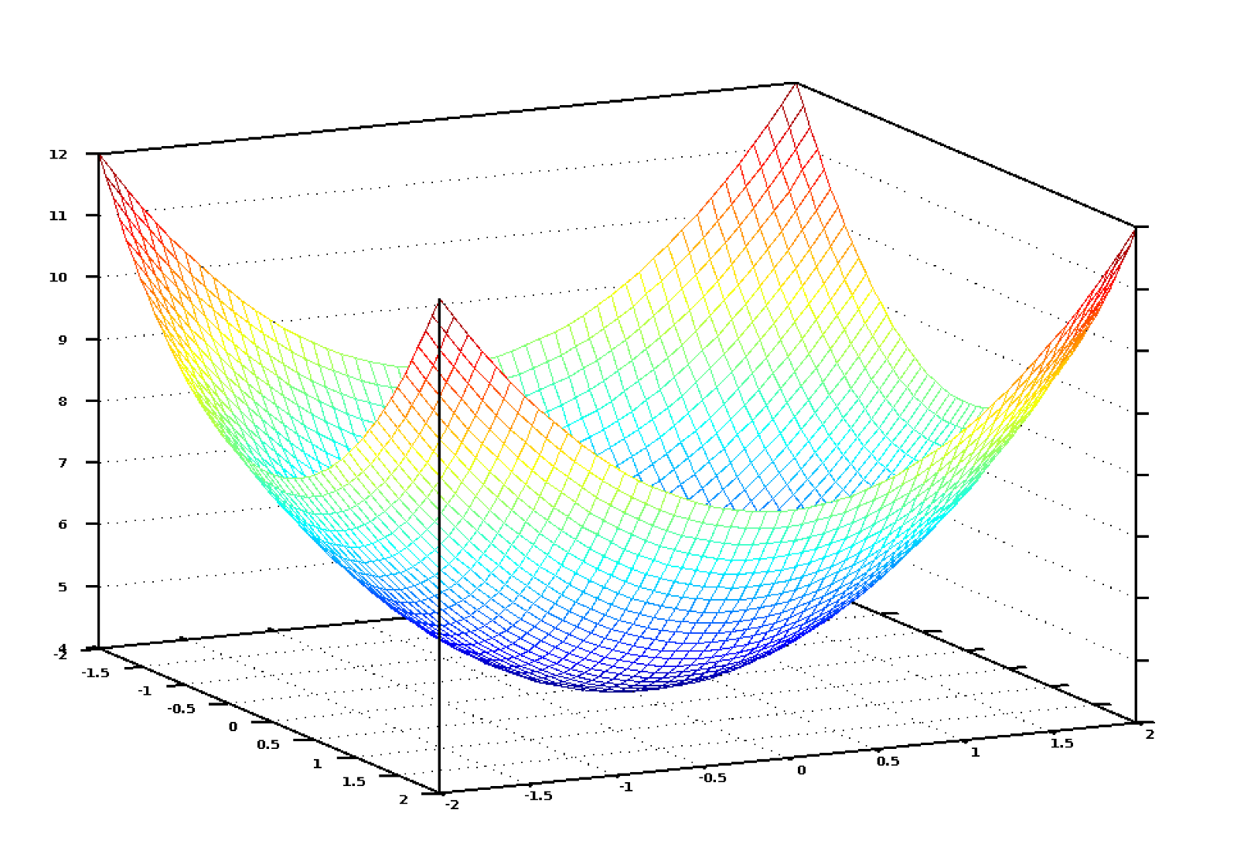
SYSTEM DESCRIPTION – COST FUNCTION

Slide 27
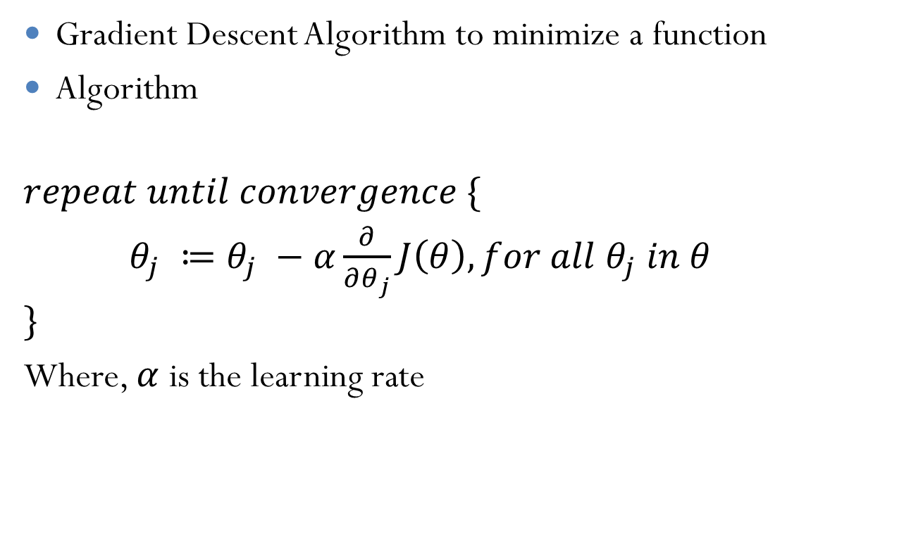
SYSTEM DESCRIPTION – GRADIENT DESCENT
Gradient Descent Algorithm to minimize a function
Algorithm
$$repeat until convergence \{$$
$θ_{j} ≔θ_{j} −α\frac{∂}{∂θ_{j}}J\left(θ\right), for all θ_{j} in θ$
$$\}$$
Where, $α$ is the learning rate

Slide 28
BLOCK DIAGRAM OF SYSTEM
As the block diagram shows, the system consists of two major blocks, takes a fundus photograph as input and returns a rating between 0 – 4 as output. The input image is first preprocessed in the “Image Preprocessing” block.
The output of the preprocessing step will either be a processed and transformed image in case of a CNN or a set of features of the image in case of other ML techniques such as Naïve Bayes or SVM. The classifier will then either learn if it is training, or produce an output if it is running in the application.

Slide 29
HARDWARE REQUIREMENTS
Developer
Minimum 4GB RAM. Higher RAM results in faster training
Minimum 100GB hard disk space
Nvidia GPU with minimum CUDA level of 3.0
User
Minimum 512 MB RAM
Processor: Minimum Core 2 Duo 2GHz or equivalent

Slide 30
SOFTWARE REQUIREMENTS
Developer
Linux OS such as Ubuntu or Mint
Python 3.5 and above
A rich text editor such as Visual Studio Code. The developer may use any text editor he/she is comfortable with
User
Basic Operating System such as Windows, Linux or Mac OS

Slide 31
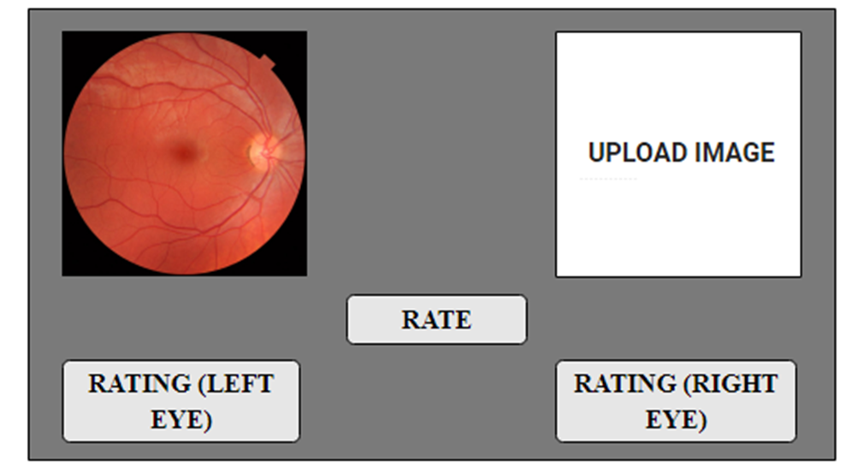
USER INTERFACE DESIGN

Slide 32
CONCLUSIONS
This project aims to build a comprehensive and automated system capable of rating color fundus photographs. The rating will be a value predicting how serious the spread of diabetic retinopathy is for the patient.
The project is meant to be used by in clinical where it can predict the rating of a patient quickly. In the future we hope to make the system more accurate which is a serious requirement of medical diagnosis systems.
The system also needs to be quick to warrant the use of such an automated system.

Slide 33
PLANS FOR NEXT SEMESTER
Next semester we will mainly be focusing on the implementation of the project
We will be designing models and training them on our dataset
We will then evaluate these models based on accuracy or similar performance evaluation and select the one with the best score
We will then implement a desktop application employing the model to predict DR classes based on input images

Slide 34
LITERATURE CITED
"National Diabetes Statistics Report, 2014." Centers for Disease Control and Prevention. January 1, 2014. Accessed December 26, 2014.
"Diabetes." World Health Organization. November 1, 2014. Accessed December 26, 2014. http://www.who.int/mediacentre/factsheets/fs312/en/.
“Convolutional Neural Networks for Diabetic Retinopathy” Harry Pratt, Procedia Computer Science.
“Digital Image Processing”, Gonzalez, Woods.

Slide 35
ACKNOWLEDGEMENTS
We take this opportunity to express our gratitude towards our project guide Ms. Vincy Joseph, St. Francis Institute of Technology, Mumbai-103, for her constant encouragement, support, constructive criticism and guidance in our endeavor, without which we would have found it difficult to maintain our tempo and enthusiasm. Working with her has been a wonderful experience.
We also thank our college authorities, who have through their meticulous planning created a comfortable co-existence of the project and college schedules.

Slide 36
THANK YOU!

